Slide 1
Walking Friend
Team 4
Jeong Minkyung
Jae Yong Kim
Kim Minji
Yeom Joonho

Slide 2
Table of contents
01 02 03 04 05 06
Motivation
Approach & Novelty
Usage scenario
System architecture overview
Technical challenges & solutions
Final deliverable

Slide 3


Motivation
People with sedentary lifestyles
People who want lightweight, gamified walking
People need fun motivation for outdoor activities

Slide 4
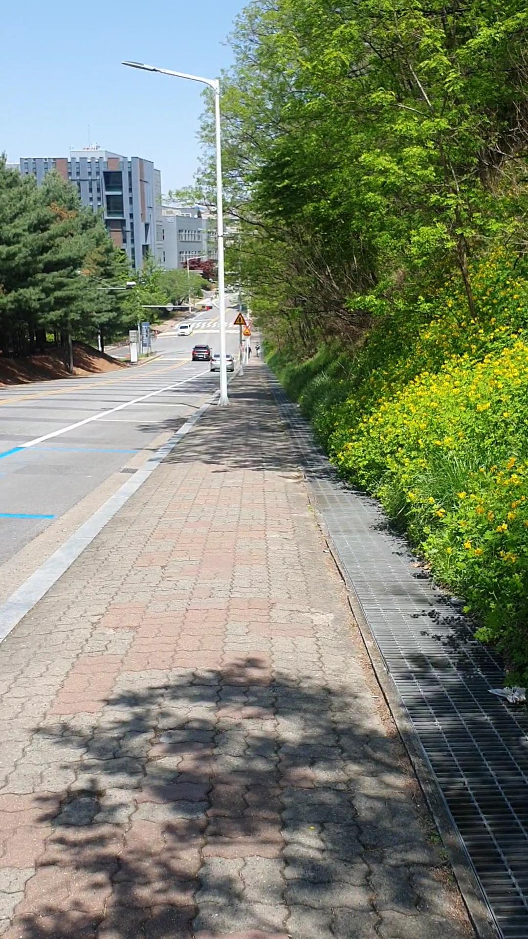

Approach
“Gamified” walking app
Interaction with character
Wow, it’s a flower!
Immediate Rewards
Feedback for today’s walk
Scene-based game interactions
Fun motivation for walking

Slide 5
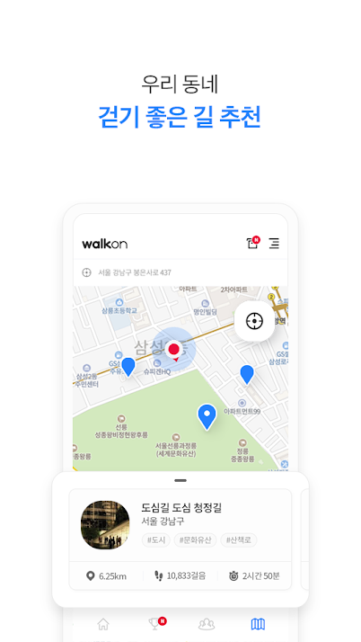
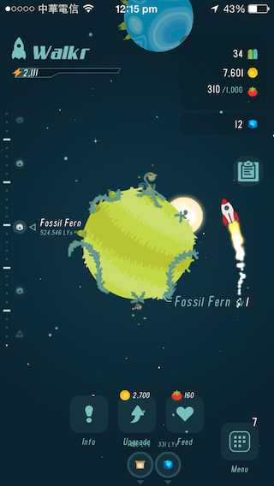
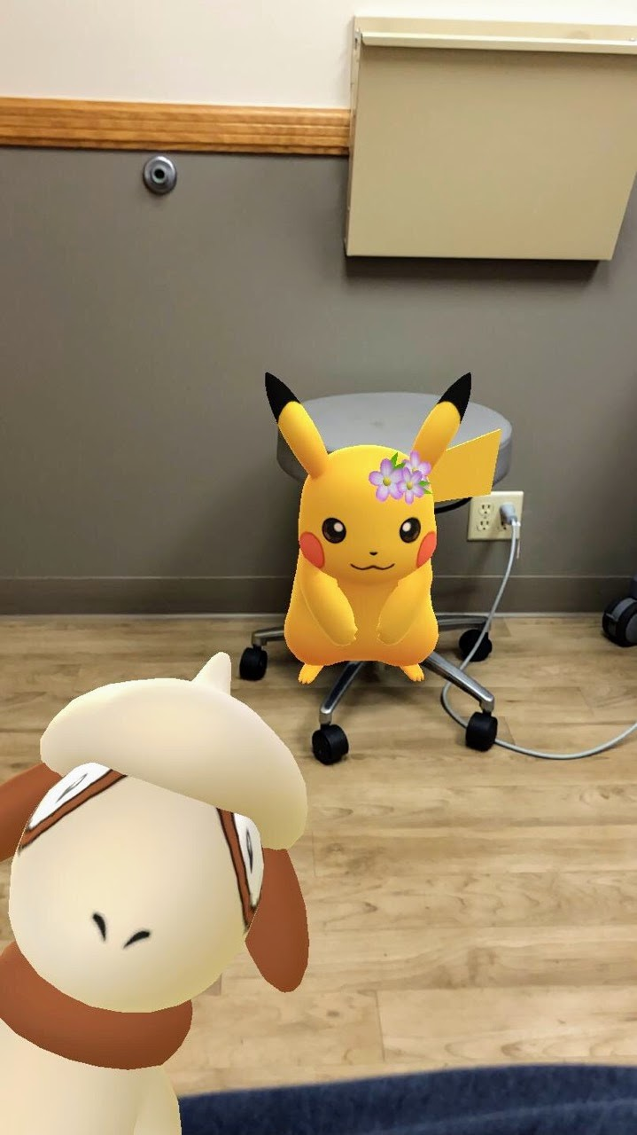
Novelty
Prior works
Feels like side job
Experiences are limited to virtual space
not directly motivate the physical activities
Ours
Interactions related physical environment
Encourages outdoor activities in natural manner
WalkON
Walkr
Pokémon GO

Slide 6
Usage Scenario
Select a Course
Walk with Friend
Get Feedback
Select a course from the recommended courses
Walk with virtual character
Get stats/coins for the walk
Collect coins from surroundings

Slide 7
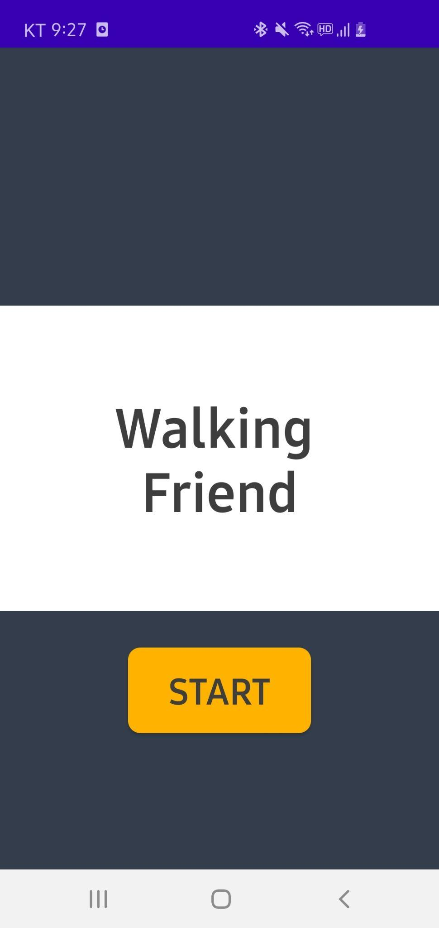
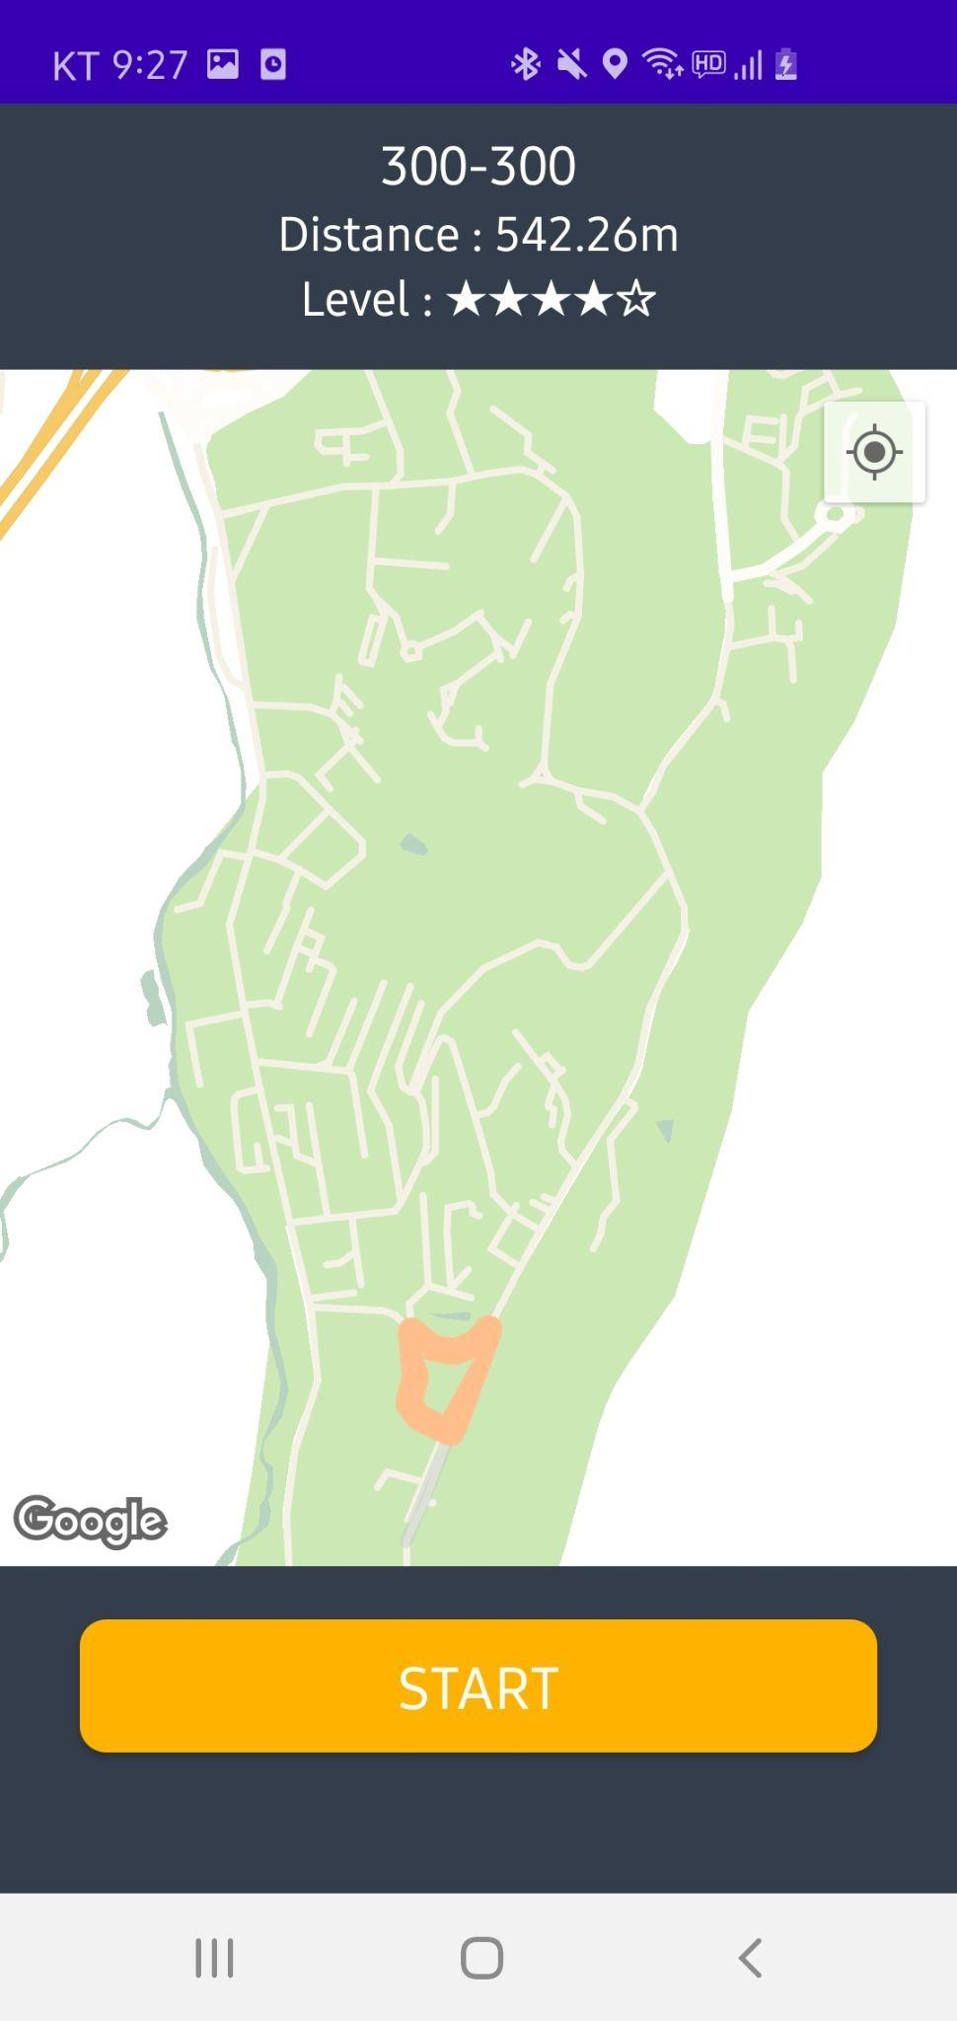
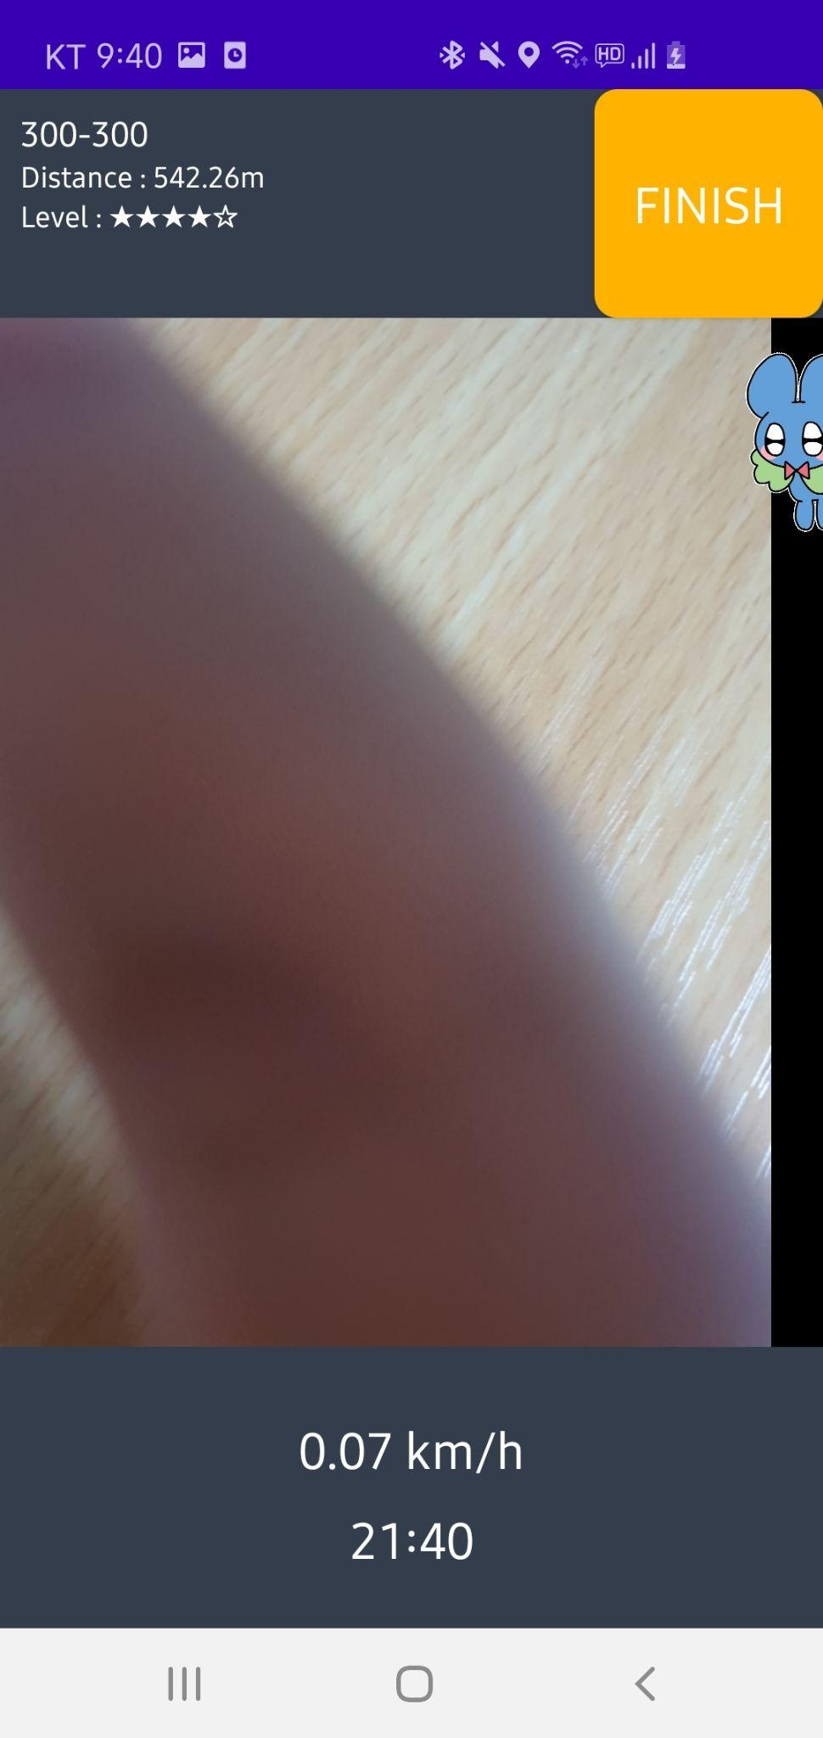
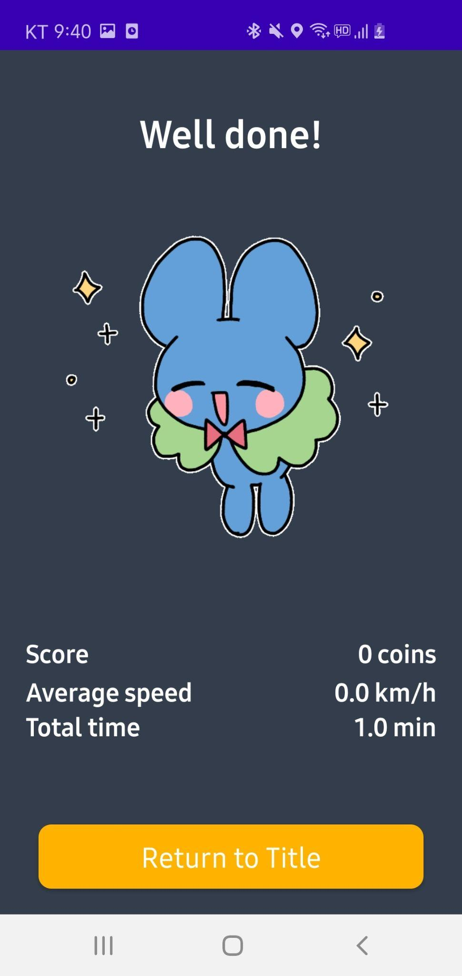
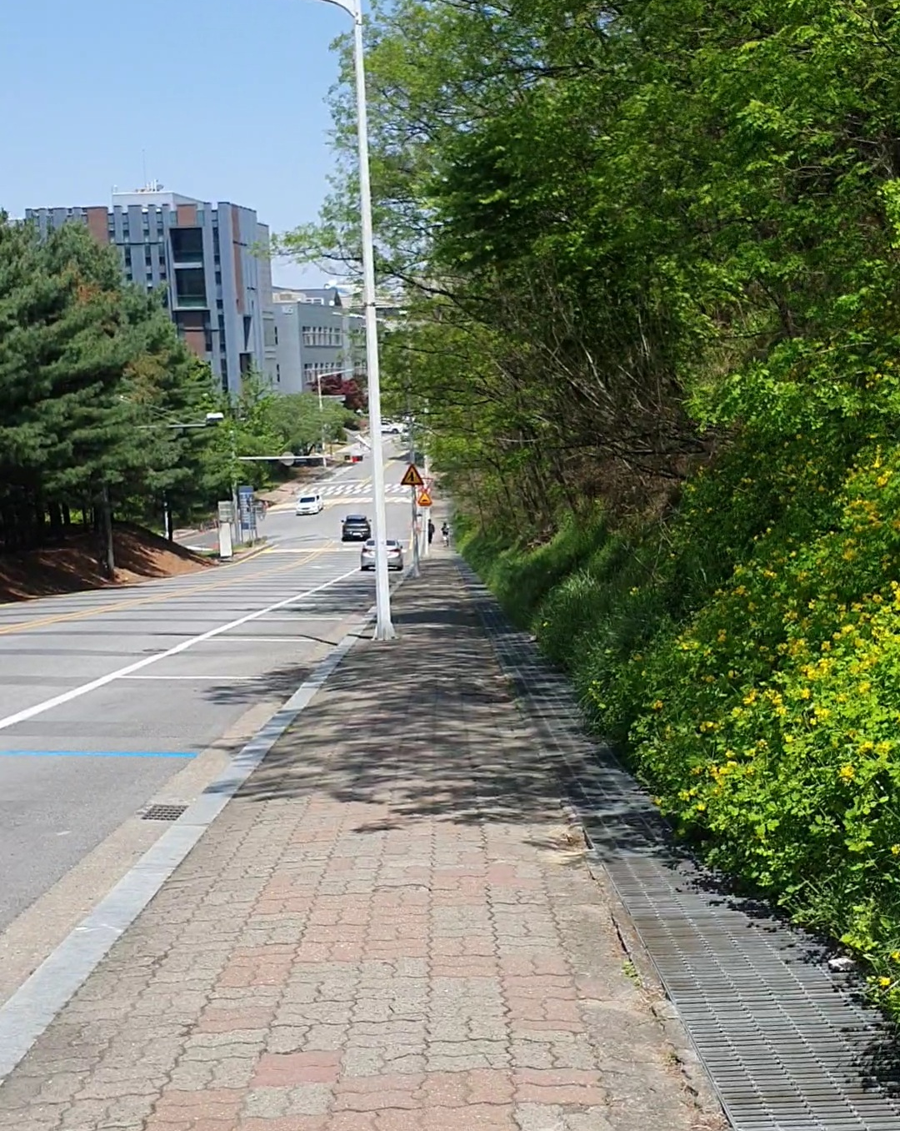

Usage Scenario
Go Back
Go Back
Finish Walking
Flower! 100 coins
Confirmed Permission
Confirmed Course
Go to Title

Slide 8
Usage Scenario
App recommends courses near the user
Get current location using Google maps API
Start walking when user selects a course
Route, distance and difficulty of the course are provided

Slide 9
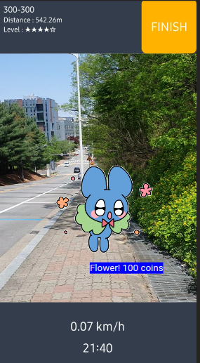
Usage Scenario
Virtual character interacts with the surroundings
Interactable objects are extracted by detection model
Character’s behavior changes depending on the scene
Users can earn coins from character’s action
Users check current walking status
App tracks user’s current walking speed
Immediate Reward
Object detection model detected flowers
➡
Current time & walking speed
➡

Slide 10
Usage Scenario
Get today’s walking stats and scores
Walking history is stored on the device
Users can check walking intensity from average speed and total walking time

Slide 11

Demo

Slide 12
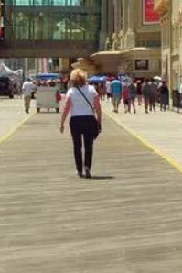

System Architecture
Object detector
Event generator
Virtual character interaction
Camera
Frames
GPS
Path tracker
Statistics
Flower! 100 coins
Course recommendation
Course selection
Google map API
Location
Sensor
Content generation
UI

Slide 13
Post-Midterm
Fine-tuning Object-detection model
Scene-interactive UI
GIF design
Detection Interaction
Achievement System
Notes:
Currently our object detection model has a mobileNet backbone architecture with a single shot multibox-detector to track the objects in the camera feed and the model is currently trained with CoCo dataset and I’m not sure if you have noticed from our demo, we still have many categories that we are planning to keep out from the scope of our project and there are objects that should be detected but not such as trees and flowers.

Slide 14
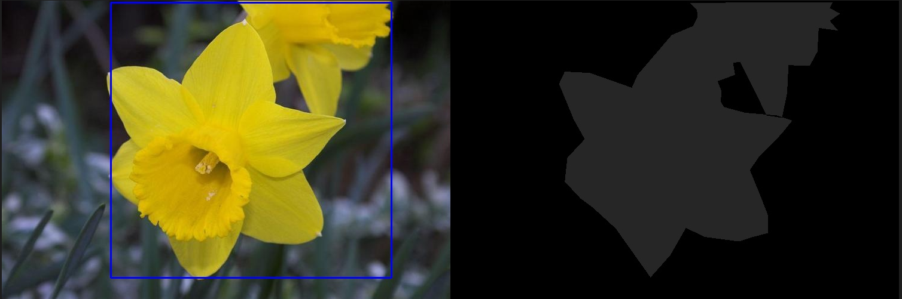
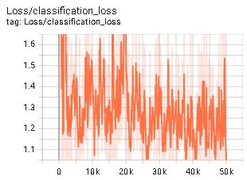
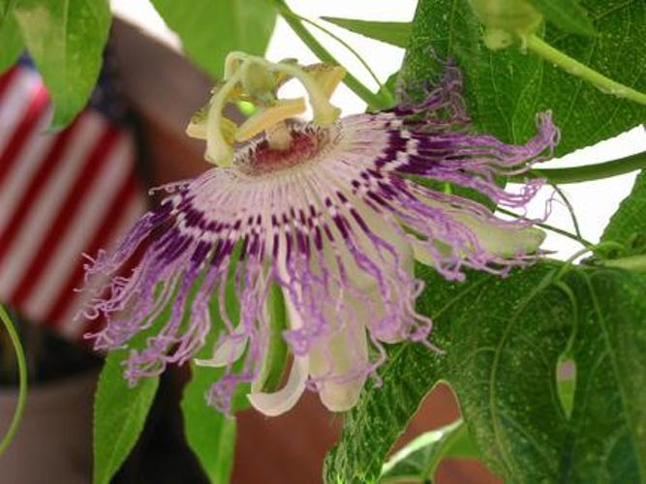

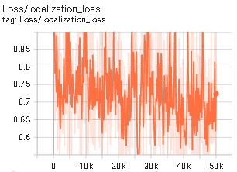
Technical/Design Challenges
Fine-tuning w/ flower - insufficient dataset
(Oxford 102 flower dataset : https://www.robots.ox.ac.uk/~vgg/data/flowers/102/)
Preprocess bounding boxes from ground truth segmentation masks
Numerous false data from dataset prevent from loss converging
Clean data
False data
Notes:
so we have come up is to fine-tune our pre-trained model with dataset that includes those categories and finding the right dataset was not easy. Most of the datasets that we could find were mostly set for flower type classification or segmentation and since we need a lot of photos to achieve certain confidence levels instead of labeling bounding boxes manually, we decided to preprocess bounding boxes from ground truth segmentation masks from the datasets

Slide 15
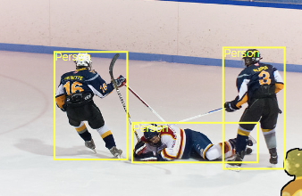
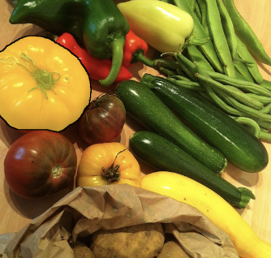
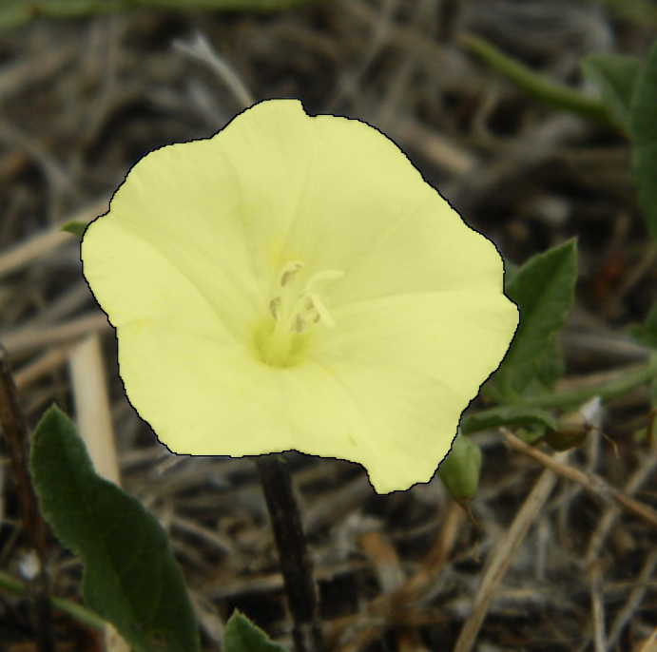
Technical/Design Challenges
Approach2: Retrieve required data from Open Image
Open Image provides 600 classes 1,743,042 training images with annotations
build data annotations from the filtered class list - Bird, Car, Dog, Flower, Person
Compose training set 300 per class, valid set 60 per class, test set 60 per class
data processing
Huge dataset
Small dataset

Slide 16
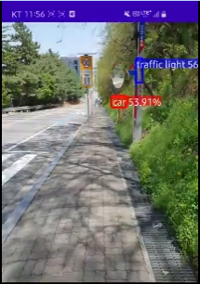
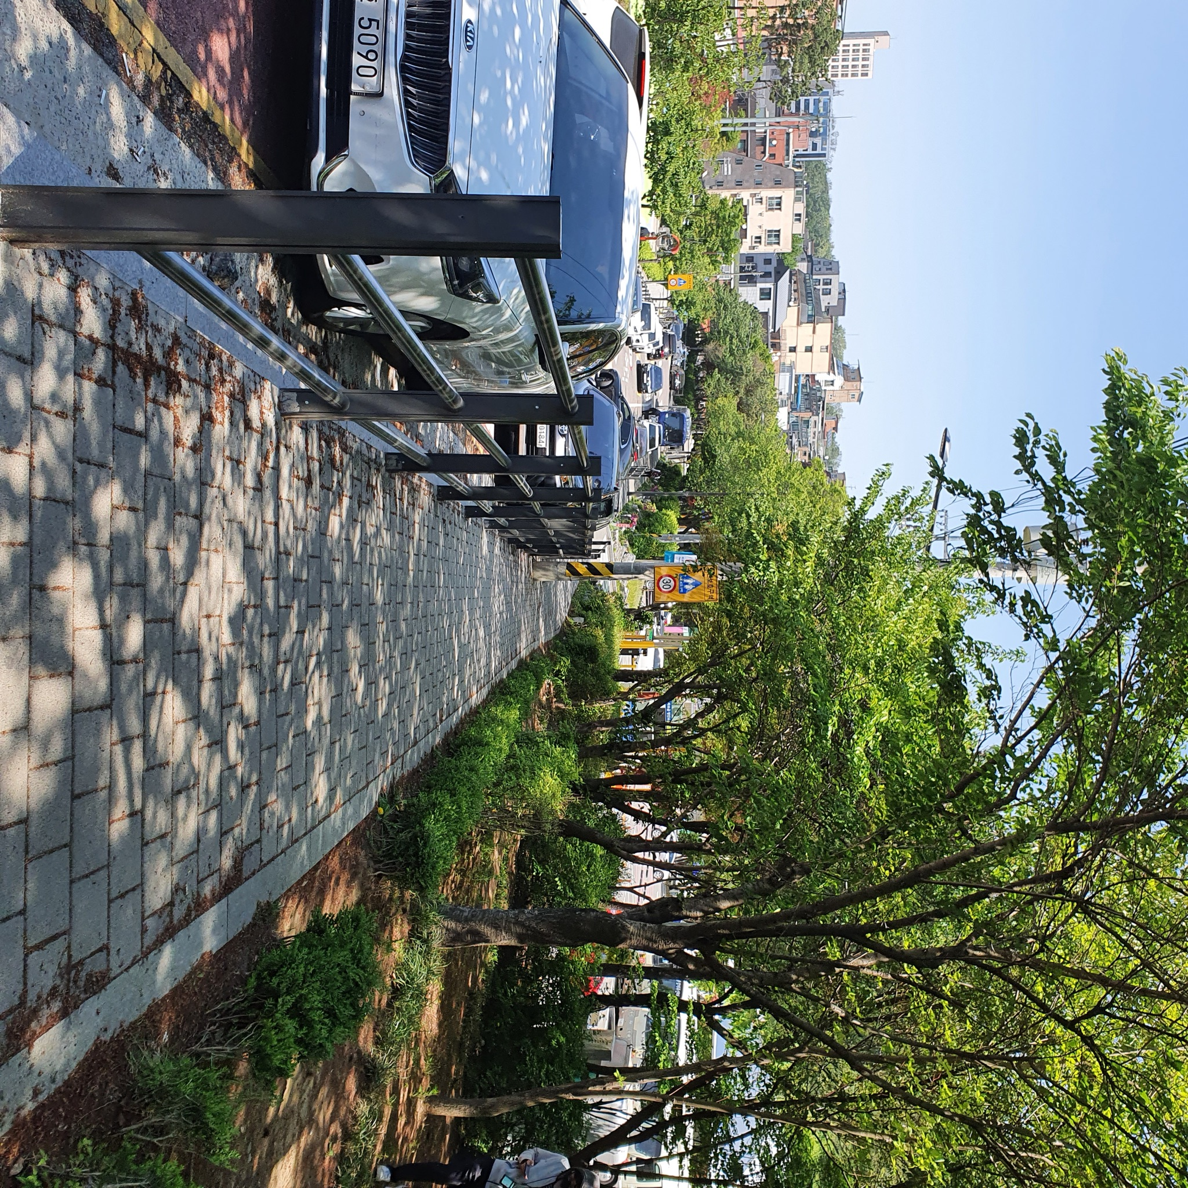
Technical/Design Challenges
?
Scene Interaction/ Achievement Settings
Numerous boxes at same time?
=> Detect one object at a time == One reward per object
Detection of objects only from the same category (e.g. car)
=> 5 second cooldowns between object detections (thread sleeping)
=> Max cap. of objects of the same class that could be detected
(Rare objects will have a higher max cap.)

Slide 17
Evaluation Results
Model: EfficinetDet-lite0
Dataset: Subset of Open Image
AP | 0.6176
AP50 | 0.8620
AP75 | 0.6752
AP | 0.6038
AP50 | 0.8566
AP75 | 0.6416
raw model
integer quantized tflite model

Slide 18
Reflections
Getting the annotated data corresponding our need still requires huge human effort.
It was hard to design a life-immersive application that is robust to the numerous exceptional cases.
Post-processing detection results into gamification systems with depth is something that needed a lot of attention.
Incorporating multiple sensing data into a system was not easy
Notes:
so we have come up is to fine-tune our pre-trained model with dataset that includes those categories and finding the right dataset was not easy. Most of the datasets that we could find were mostly set for flower type classification or segmentation and since we need a lot of photos to achieve certain confidence levels instead of labeling bounding boxes manually, we decided to preprocess bounding boxes from ground truth segmentation masks from the datasets

Slide 19
Final Deliverable / Success Criteria
Object Detection
Detects objects well that are meant to be detected (e.g. flower, person, cars)
Correctly classifies the current scene in the camera
Gamification
Generate gamified interactions along with detection result
Course Recommendation
Accurate tracking of the user’s current location
Correct statistical feedback after completion of a course

Slide 20
Project Breakdown
Tasks | 3 | 4 | 5 | 6 | 7 | 8 | 9 | 10 | 11 | 12 | 13 | 14 | 15
Android / Unity Development Study | ALL | ALL
UI design |  | ALL
UI implementation |  | MJ, JY | MJ, JY
Build interaction contents and walking courses |  |  | ALL | ALL
Location-aware interaction implementation |  |  |  | MK | MK
Object Detection model implementation |  |  |  | JY, JH | JY, JH
Feature integration |  |  |  |  |  | ALL
Mid-term presentation |  |  |  |  |  |  | MK, JY
Scene-aware Interaction |  |  |  |  |  |  |  | MJ, MK | MJ, MK | MJ, MK
Reward & reporting system implementation |  |  |  |  |  |  |  |  | MJ, JY | MJ, JY
Performance Optimization |  |  |  |  |  |  |  |  | JH | JH
Evaluation & Regression |  |  |  |  |  |  |  |  |  | ALL | ALL
QA |  |  |  |  |  |  |  |  |  |  | ALL | ALL
Presentation & Demo |  |  |  |  |  |  |  |  |  |  |  |  | ALL

Slide 21
Thanks
Do you have any questions?

